Slide 1


Adventure works cycles
Data Analyst Project
Excel
Power-BI
Tableau
MySQL
Group – 1
Khandesh Sri Narasimha
Honey kedia
Bijal Manish Rana
Kunal Krishna Ayere

Slide 2
Introduction
Adventure Works Cycles is a multinational manufacturing company specializing in metal and composite bicycles. Headquartered in Bothell, Washington, the company operates with a workforce of 290 employees and regional sales teams across North America, Europe, and Asia. In the 2000s, Adventure Works expanded by acquiring a manufacturing plant in Mexico, which produces critical subcomponents for their product line.
Aim of the Company:
Adventure Works Cycles aims to expand its market share by focusing on its best customers, increasing product availability through an external website, and reducing production costs to lower the cost of sales.

Slide 3
Dataset Overview
Datasets | Fact internet sales new | Fact internet sales | Dim Customer | Dim date | Dim Product | Dim Product Category | Dim product Sub-Category | Dim Sales Territory
No. of row | 54,772 | 5,628 | 18,485 | 3,653 | 607 | 5 | 38 | 12
No. of Feature | 26 | 26 | 29 | 19 | 36 | 5 | 6 | 5
Data Types | Numeric, categorical & date/time | Numeric, categorical & date/time | Numeric, categorical | Numeric, categorical & date/time | Numeric, categorical | Numeric, categorical | Numeric, categorical | Numeric, categorical
Important Features | Productkey OrderDatekey Orderdate CustomerKey SalesTerritoryKey OrderQuantity UnitPrice UnitPriceDiscountPct ProductStandardCost TaxAmt TotalProductCost SalesAmount | Productkey OrderDatekey Orderdate CustomerKey SalesTerritoryKey OrderQuantity UnitPrice UnitPriceDiscountPct ProductStandardCost TaxAmt TotalProductCost SalesAmount | CustomerKey FirstName MiddleName LastName Gender English education | DateKey DayNumberOfWeek EnglishDayNameOfWeek MonthNumberOfYear CalendarQuarter CalendarYear CalendarSemester FiscalQuarter FiscalYear | ProductKey Unit price ProductSubcategoryKey EnglishProductName SafetyStockLevel ReorderPoint | ProductCategoryKey EnglishProductCategoryName | ProductSubcategoryKey EnglishProductSubcategoryName ProductCategoryKey | SalesTerritoryKey SalesTerritoryRegion SalesTerritoryCountry SalesTerritoryGroup

Slide 4
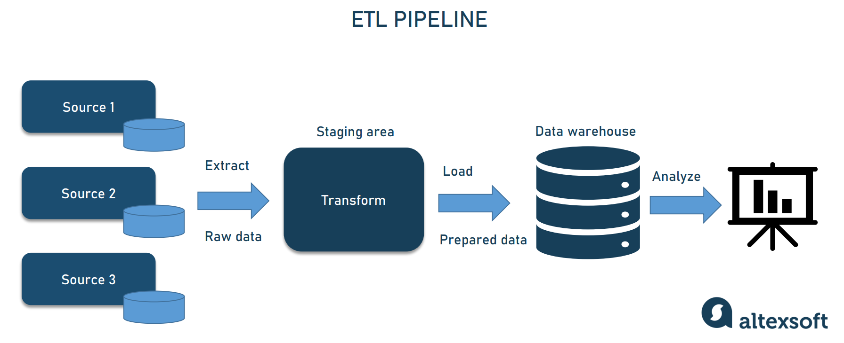
Data analyst cycle (ETL Process)

Slide 5

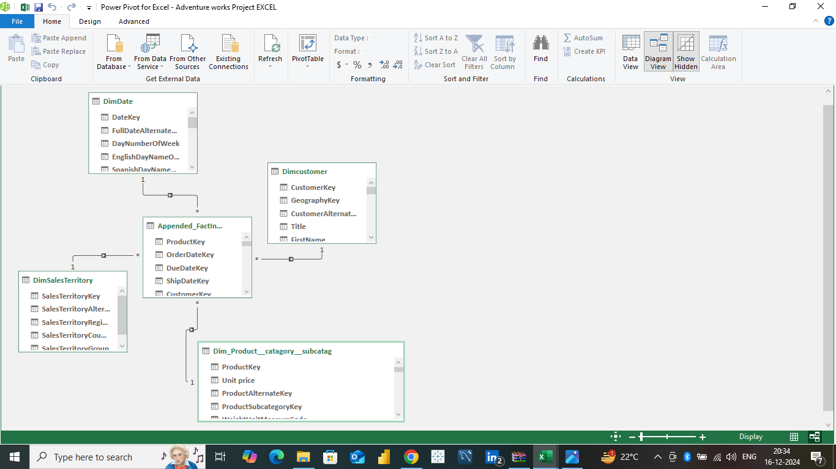
Excel Data modelling

Slide 6
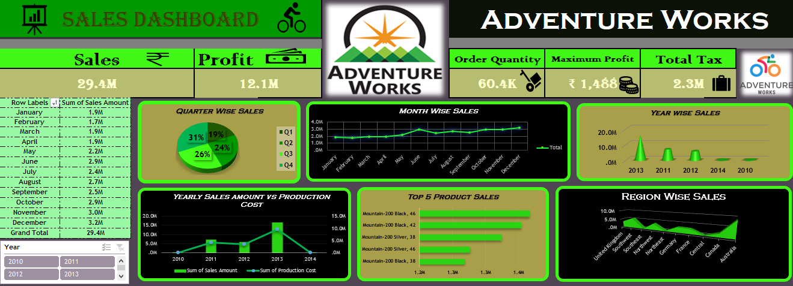
Excel Dashboard-1

Slide 7
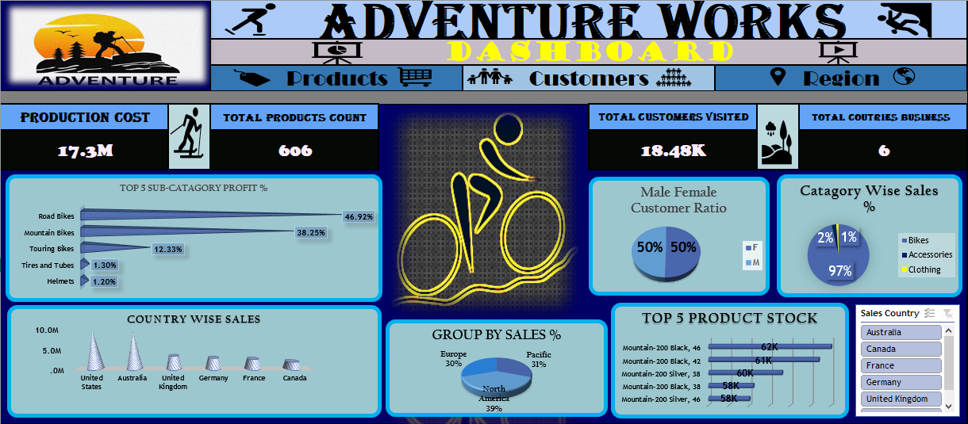
Excel Dashboard-2

Slide 8
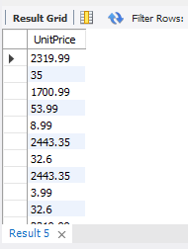
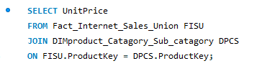
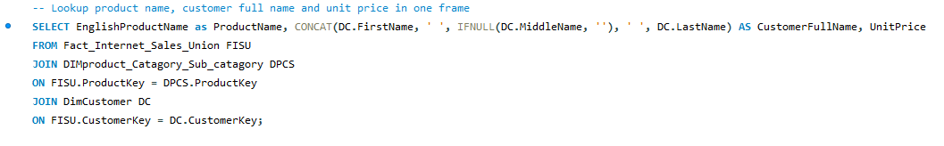
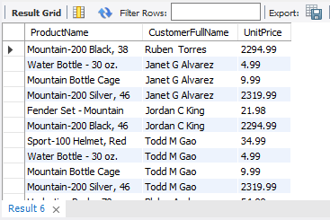
MYSQL
Lookup the Unit Price from Product sheet to Sales sheet.
Lookup product name, customer full name and unit price in one frame

Slide 9
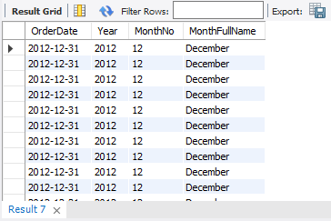
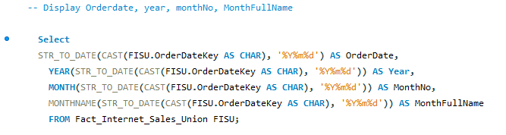
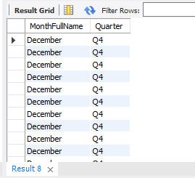
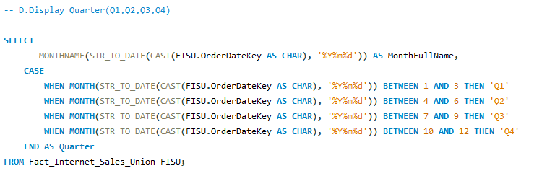
Calculate the following fields from the Orderdatekey field ( First Create a Date Field from Orderdatekey)
Display Order Date, Year, MonthNo, Month Full Name
Display Quarter(Q1,Q2,Q3,Q4)

Slide 10
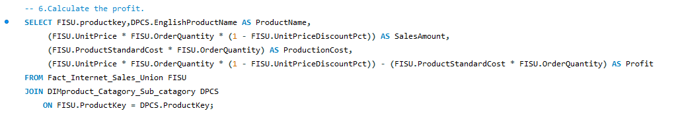
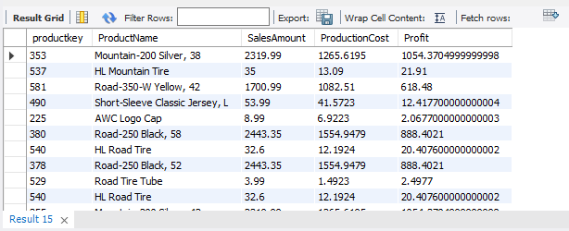
Calculate the profit, Display Sales amount, Production Cost and Profit

Slide 11
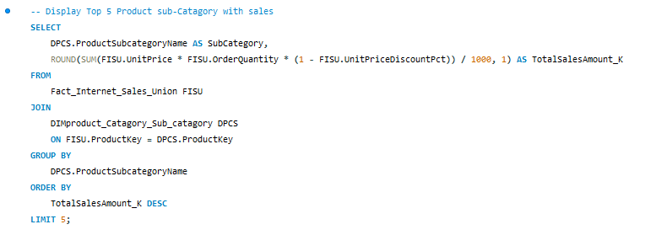
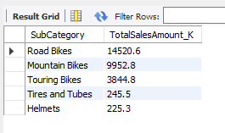
Display Top 5 Product Sub-Category with Sales

Slide 12
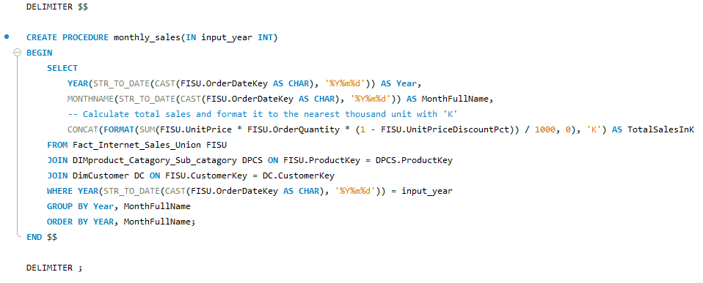
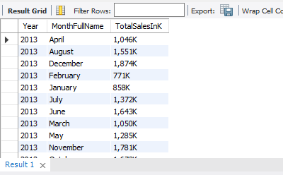
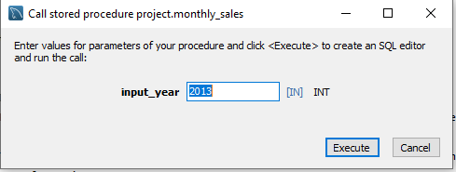
Stored procedure : to filter the year to display monthly Sales Amount

Slide 13

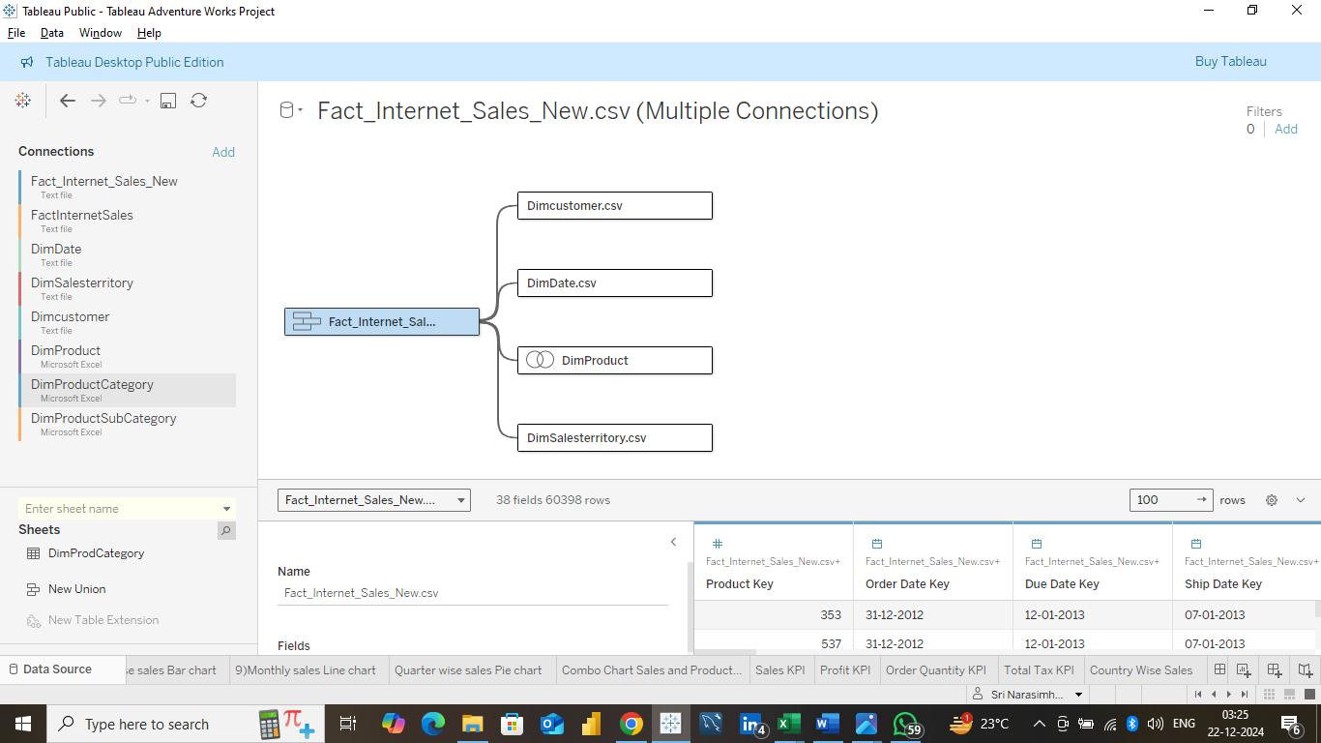
Tableau Data Modelling

Slide 14
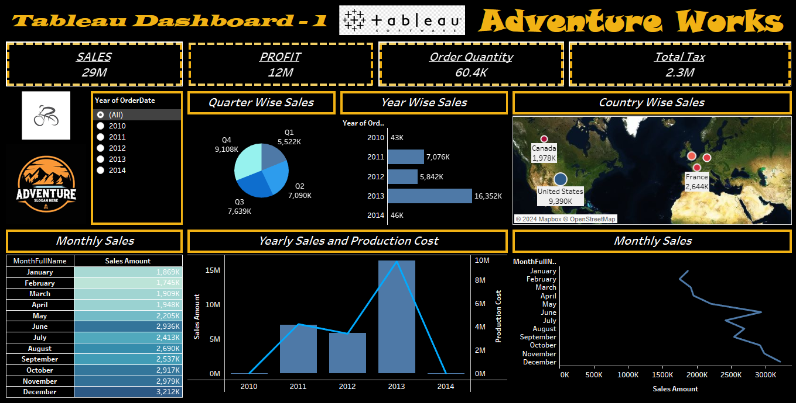
Tableau Dashboard-1

Slide 15
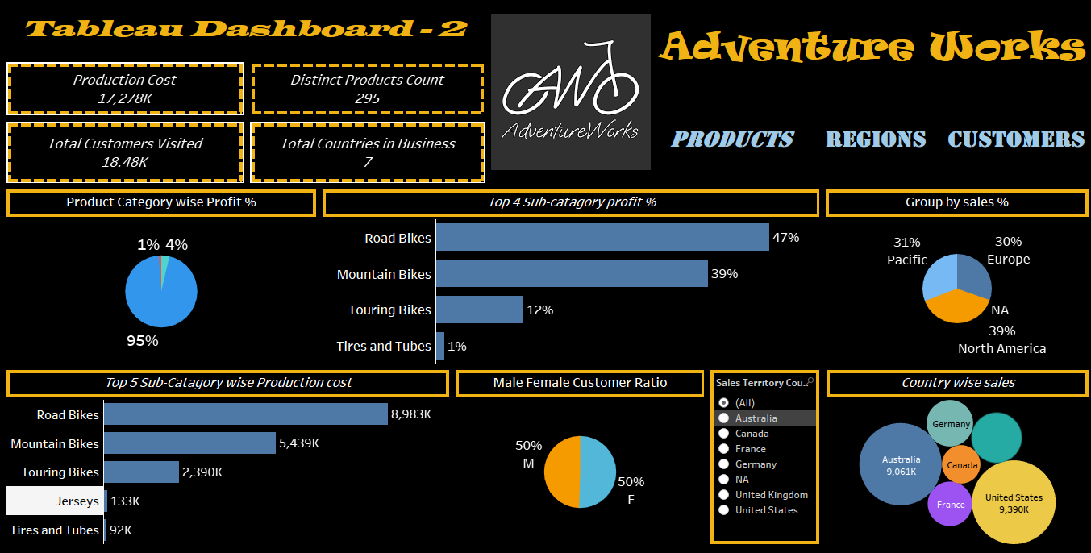
Tableau Dashboard-2

Slide 16

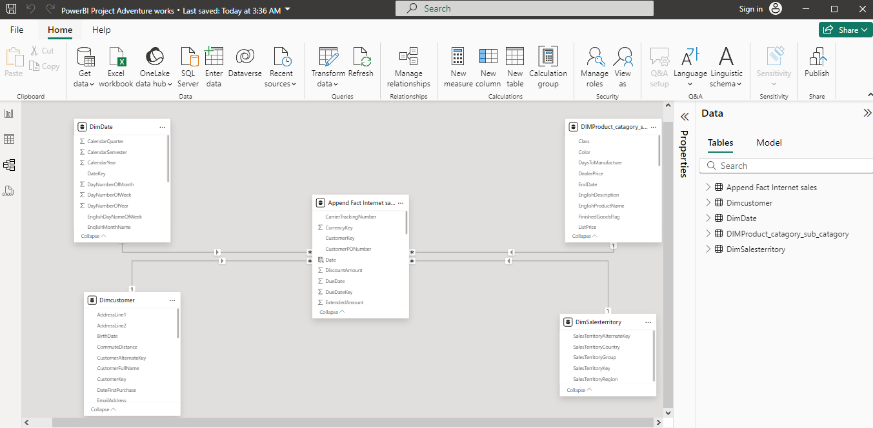
Power-BI DATA MODELLING

Slide 17
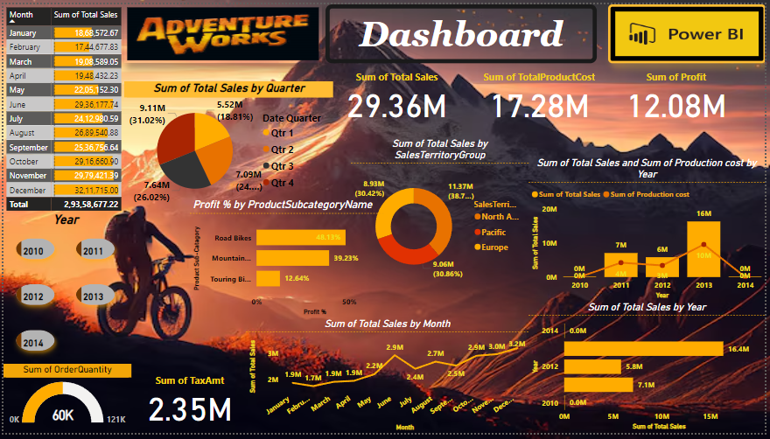
Power-BI Dashboard-1

Slide 18
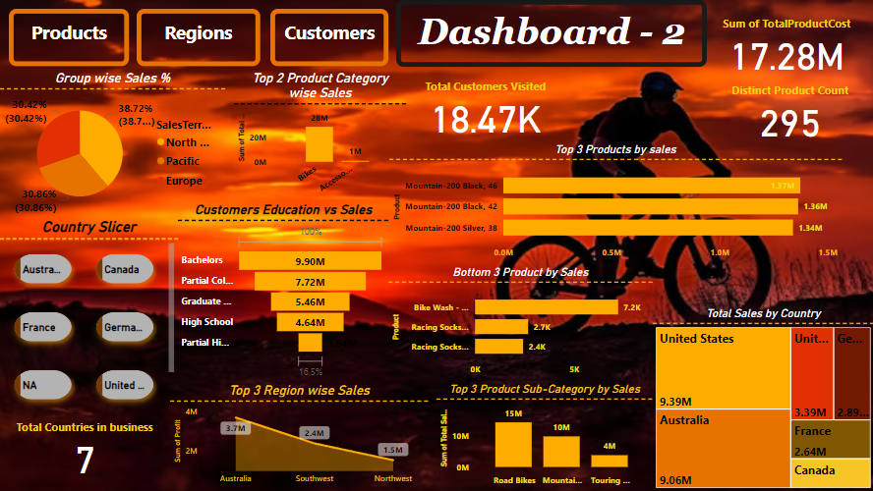
Power-BI Dashboard-2

Slide 19
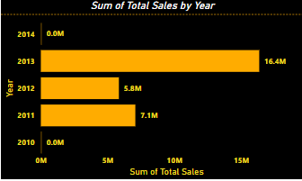
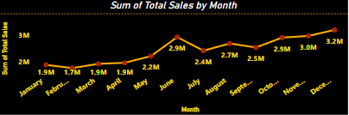
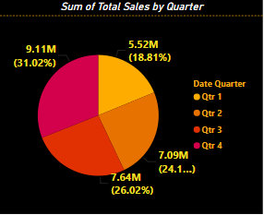
1) KPI : Trends of sales – year , month & quarter
Analysis
Key Insights:
Sum of Total Sales trended up, resulting in a 5.24% increase between 2010 and 2014.﻿
December Sales Spike: December has the highest sales (₹0.32 million), 84% higher than February. Capitalize on December for peak sales.
Seasonal Trends: Sales are lowest in February, so consider targeted campaigns to boost sales during this period.
Quarter 4 Leads: Quarter 4 generates the highest sales (31.02%). Plan for Q4 promotions to maximize sales.
Business Recommendation :
Maximize efforts in Q4 and December to capitalize on peak sales.
Focus on improving sales in Q1 and February to balance seasonal dips.

Slide 20
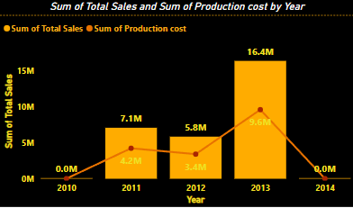
2) KPI : sales vs production cost
Analysis
Key Insights:
Sales up by 5.24% and Production costs down by 21.24% between 2010-2014.
Profitability Potential: The combination of increasing sales and decreasing production costs presents a strong opportunity for higher profitability.
Business Recommendation :
Capitalize on efficiency to maximize profit.
Reinvest savings into growth and market expansion.

Slide 21
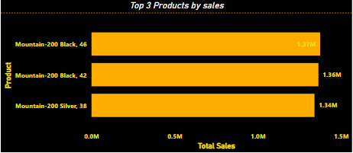
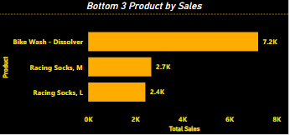
3) KPI : Top 3 and bottom 3 product sales
Analysis
Key Insights:
Bike Sales Dominate: The Mountain-200 Black series consistently outperforms accessories, with each model contributing over ₹1.3 million in sales, compared to just ₹12K combined from the bottom three accessories. Focus on promoting the Mountain-200 series as the main revenue driver.
Accessory Sales Struggling: Items like bike wash dissolver and racing socks have minimal sales. This indicates low demand for accessories. Consider bundling these products with bikes or offering promotions to boost interest.
Low-Interest Accessories: There's a clear consumer preference for bikes over accessories. To improve sales for smaller items, reduce pricing or create bundled offers with bikes to enhance their appeal.
Business Recommendation :
Focus on boosting bike sales, especially the Mountain-200 Black series.
Reevaluate accessory pricing or bundle them with bike purchases for increased visibility and sales.

Slide 22
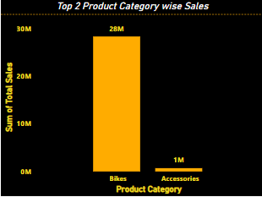
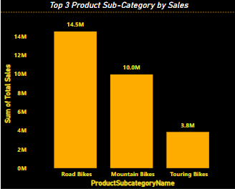
4) KPI : Product category and sub-category sales
Analysis
Key Insights:
Bikes Overwhelmingly Lead Sales: Bikes dominate, with ₹28 million in sales compared to just ₹1 million from accessories. Prioritize bike sales as the key growth driver.
Mountain Bikes Are Most Profitable: While road bikes lead in sales, mountain bikes offer the highest profit margin at 39%, compared to 18% for road bikes and 13% for touring bikes. Focus on promoting mountain bikes to maximize profitability.
Profitability vs Sales: Although road bikes have the highest sales, mountain bikes offer significantly higher profits. Balance sales efforts to boost both revenue (road bikes) and profit (mountain bikes).
Business Recommendation :
Focus on increasing sales of mountain bikes to leverage their higher profit margin.
Maximize bike sales overall, but consider offering strategic promotions for road bikes to sustain their high volume.
Reevaluate accessory offerings, as they contribute minimally to overall sales.
Top 3 Sub-category | Sales | Profit
Road Bikes | ₹14.5 million | 18%
Mountain Bikes | ₹10 million | 39%
Touring Bikes | ₹3.8 million | 13%

Slide 23
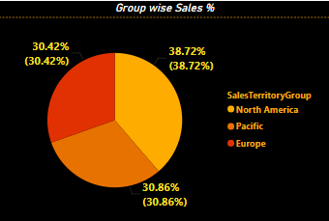
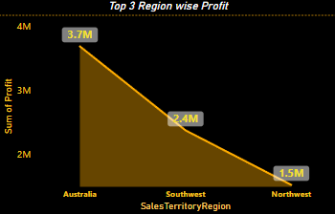
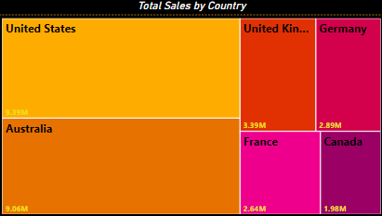
5) Kpi : performance by Region
Analysis
Key Insights:
North America leads with 38.72% sales, driven by the United States (₹9.39 million), surpassing Australia (₹9.06 million).
Australia performs well with ₹3.7 million in profit, ahead of Southwest and Northwest regions.
Top 3 Countries (US, Australia, UK) contribute a significant portion of total sales. Focus on these for sustained growth.
Business is active in 7 countries, but prioritize top performers (US, Australia, UK) for now.
Business Recommendation :
Strengthen efforts in North America, particularly in the United States, as it leads in total sales.
Increase focus on Australia and Southwest regions, capitalizing on their strong performance.
Prioritize growth in the United Kingdom and Germany, as they are the next highest contributors.

Slide 24
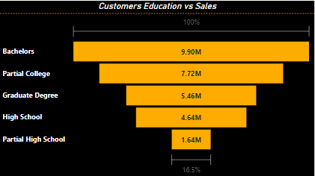
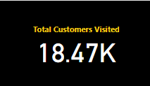
6) KPI : performance by Customers
Analysis
Key Insights and Business Recommendation:
Bachelor's degree holders drive the highest sales (₹9.90 million). Focus marketing on this group. Prioritize Bachelor's degree holders for higher sales
Partial College and Graduate degree customers also show strong sales, suggesting good potential in these segments.
Target Partial College and Graduate degree customers for additional sales.
High School and Partial High School customers generate lower sales, so simpler products or promotions might be needed for them.

Slide 25
Conclusion
Seasonal Sales Trends: Focus on replicating 2013’s success, Q4 and December show the highest sales, indicating peak demand during these periods. Maximize sales efforts during Q4 and December, while addressing slower months like February.
Bikes Drive Revenue: Bike sales dominate, with Mountain-200 Black models leading both in total sales and profitability. Focus on promoting high-performing bike models like Mountain-200 Black for sustained growth.
Accessories Underperform: Accessories contribute minimally to sales. Consider bundling them with bikes or offering promotions to increase their appeal.
Key Markets for Growth: North America, particularly the United States, is the highest contributor to sales. Focus on US, Australia, and UK for targeted growth, while leveraging strong performance in Southwest regions.
Customer Demographics: Customers with Bachelor's degrees contribute the highest sales. Tailor marketing strategies to target this educated demographic, while considering simplified products and promotions for High School-level customers.
Cost Efficiency: Production costs have decreased significantly (21.24%), while sales have increased (5.24%). This presents an opportunity to boost profit margins. Continue focusing on cost control and operational efficiency.

Slide 26
Thank You

